Slide 1
Atmospheric dynamic process: Air pollution risk assessment
A course introduction
http://online.num.edu.mn/courses/course-v1:NUM+ENVI+2021t1/about

Slide 2
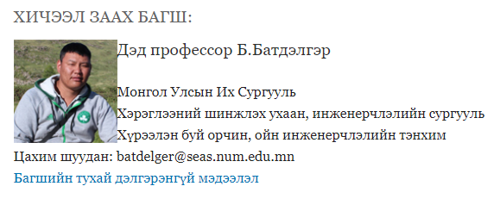
Lecturer and course

Slide 7
E-course component
About course
Syllabus
Lectures and videos
Compulsory study book
Additional study materials
Discussion
Assignment and result
Students can join anytime in the term.

Slide 8
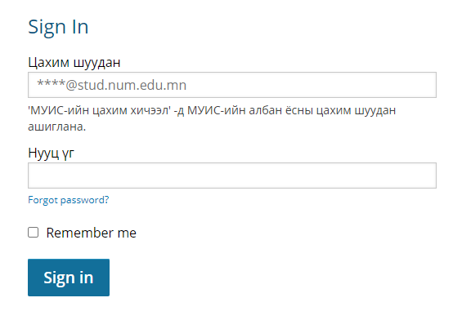
Online course http://online.num.edu.mn/courses/course-v1:NUM+ENVI+2021t1/about
Sign-in the e-course using student number. See and download syllabus

Slide 9
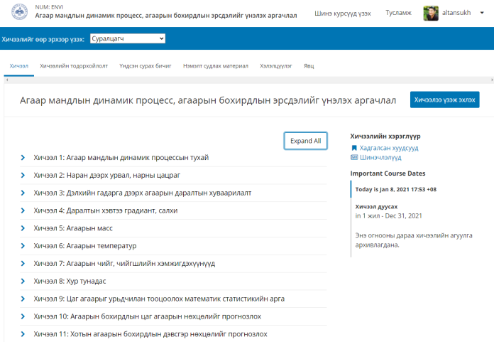
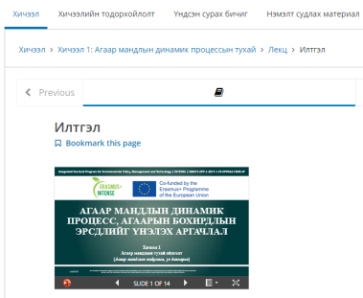
Online course http://online.num.edu.mn/courses/course-v1:NUM+ENVI+2021t1/about
List of all lectures look like this. To start to see lecture, press here

Slide 10
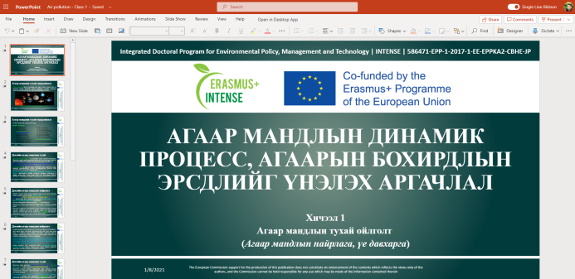
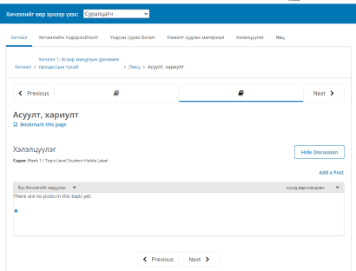
Online course http://online.num.edu.mn/courses/course-v1:NUM+ENVI+2021t1/about
All lectures look like this. Students post question, if they have

Slide 11
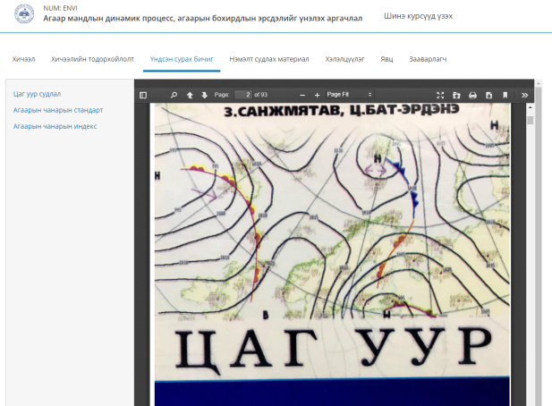
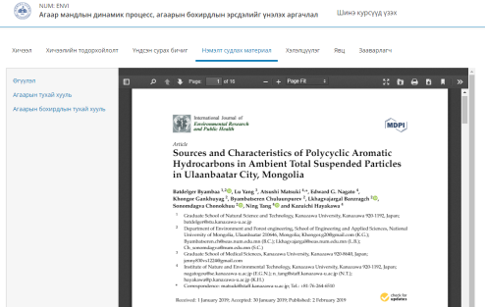
Online course http://online.num.edu.mn/courses/course-v1:NUM+ENVI+2021t1/about
Compulsory study book Additional study materials

Slide 12
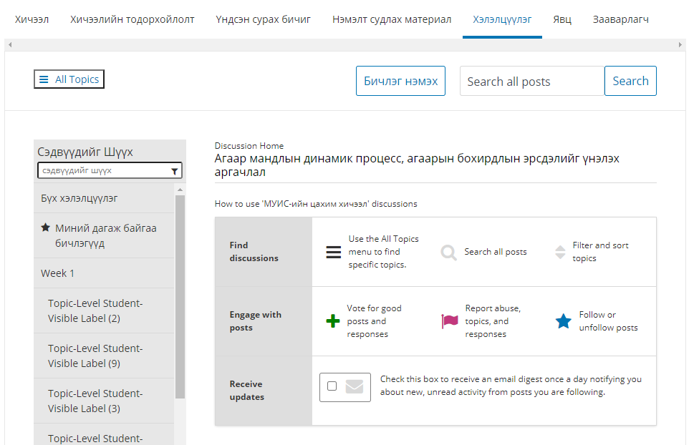
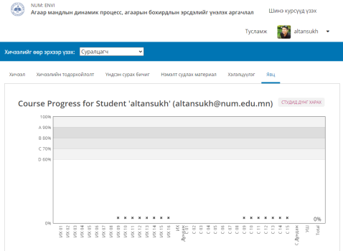
Online course http://online.num.edu.mn/courses/course-v1:NUM+ENVI+2021t1/about
Discussion section Assignment and result

