Slide 1
Optimization of Environmental Management
Course presentation:
ERASMUS+ project “INTEGRATED DOCTORAL PROGRAM FOR ENVIRONMENTAL POLICY, MANAGEMENT AND TECHNOLOGY – INTENSE”

Slide 2
Summary
The course on ‘Optimization of Environmental Management’ is intended for post-graduate (PhD) students, who conduct research in the field of environmental control.
The course is assumed to increase the level of knowledge and skills of PhD students in the issues on optimization of environmental management in environmental conservation research.
The course implies mastering of the theoretical fundamentals of nature management, which are the basis for the sustainable use of natural resources and conditions, as well as management of natural systems.

Slide 3
Aims and objectives
The course is aimed at teaching of post-graduate (PhD) students in the basic definitions in the field of environmental management, the principles of classification of natural resources, the laws (rules) of optimal nature management in research within a specific topic of doctoral (PhD) thesis.
The brevity of the ‘Optimization of Environmental Management’ course implies the accelerated integration of knowledge and skills in the learning process at the first and second levels. Optimization of environmental management is the basis for conservation and restoration of natural resources and conditions and is grounded upon a large number of various methods and environmental technologies. During the previous training, PhD students have already obtained a basic background in these disciplines.

Slide 4
Aims and objectives
The course objectives are as follows:
● updating the background of PhD students in the environmental aspects of nature management.
● detailed acquaintance of course-takers with the basic definitions in the field of environmental management.
● acquaintance of course-takers with the principles of classification of natural resources and the possibilities of their use;
● in-depth study of the theoretical fundamentals of optimal environmental management;
● in-depth study of the principles of self-governance and artificial management of natural systems;
● making choice of one or more approaches to optimization of environmental management by a postgraduate student for finding solution to a specific scientific problem.

Slide 5
General learning outcomes
Upon completion of the course,
PhD students are to gain new knowledge and develop the competencies they have
ability to master theoretical and practical issues in the field of optimization and greening of environmental management
ability to grasp the ecological component of environmental management

Slide 6
Syllabus

Slide 7
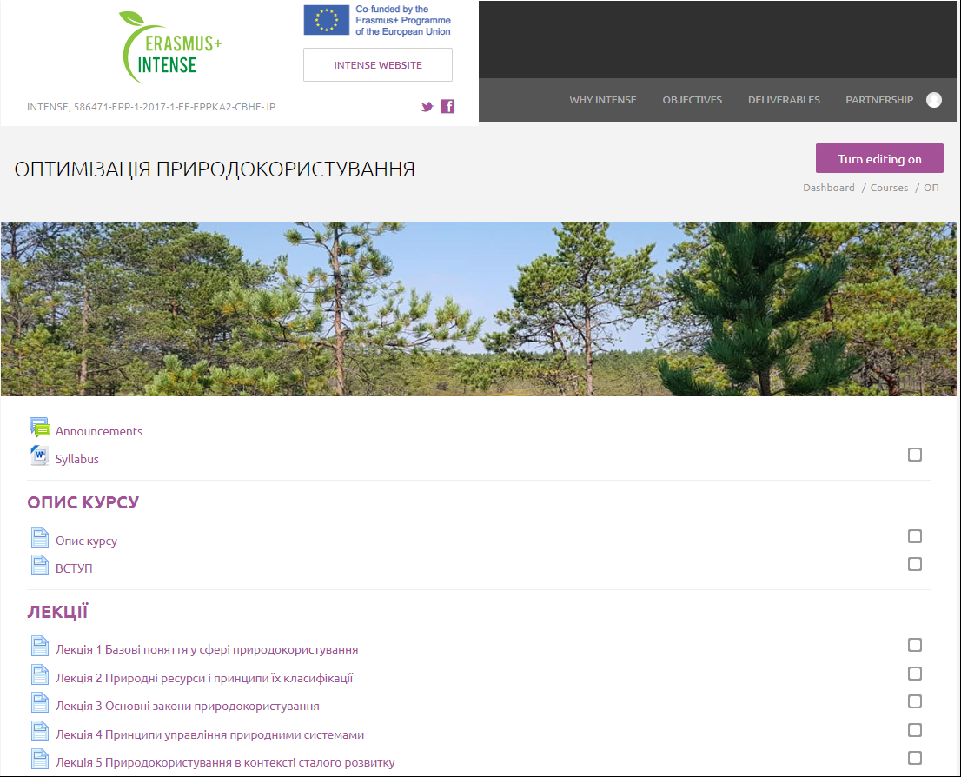
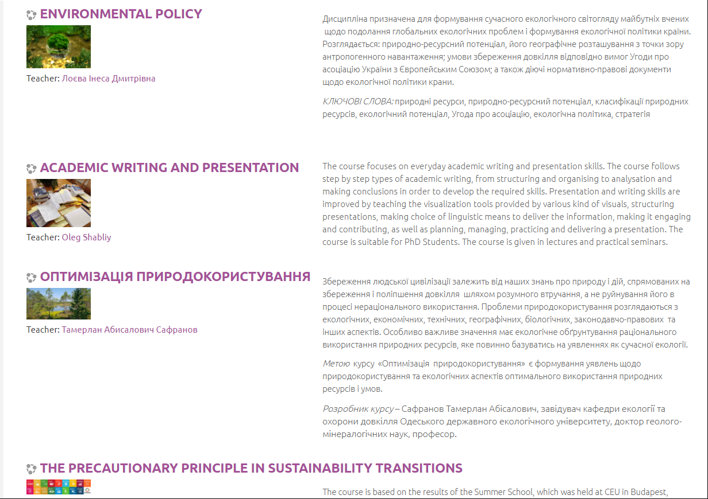
The course is available on the INTENSE open education platform dl.intense.network
http://dl.intense.network/course/view.php?id=24

Slide 8
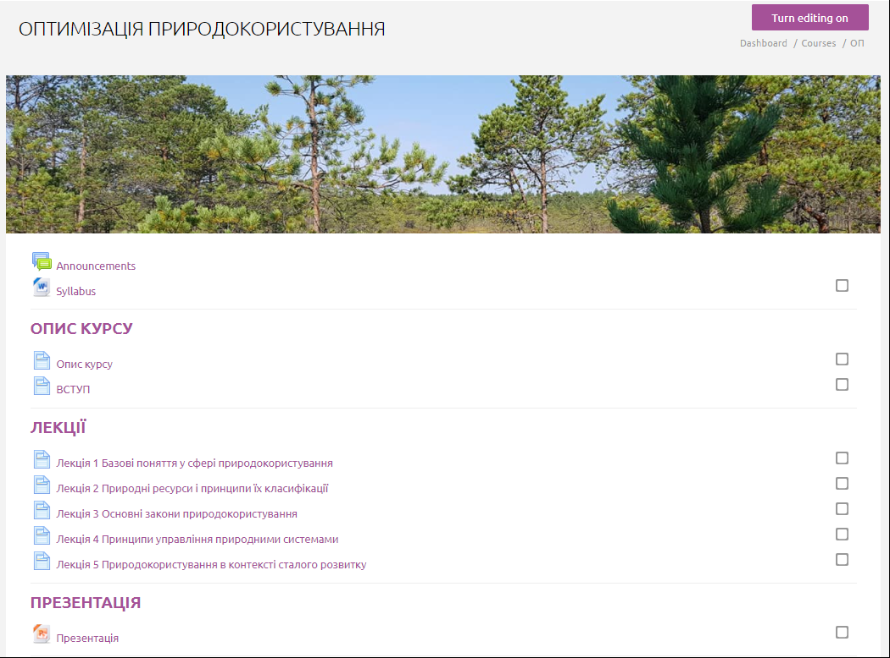

The course is available on the INTENSE open education platform dl.intense.network

Slide 9
Types and forms of classes, methods of interaction between teacher and student
The course ‘Optimization of Environmental Management’ is studied by PhD students in the term 1. The teaching methods include lectures, seminars, and independent work.
The course includes
theoretical material: lectures in html, a presentation, a video lecture
practical tasks
self-control questions
final knowledge control tests
a glossary
The course consists of a complex of lectures on 5 topics and 2 practical tasks.

Slide 10
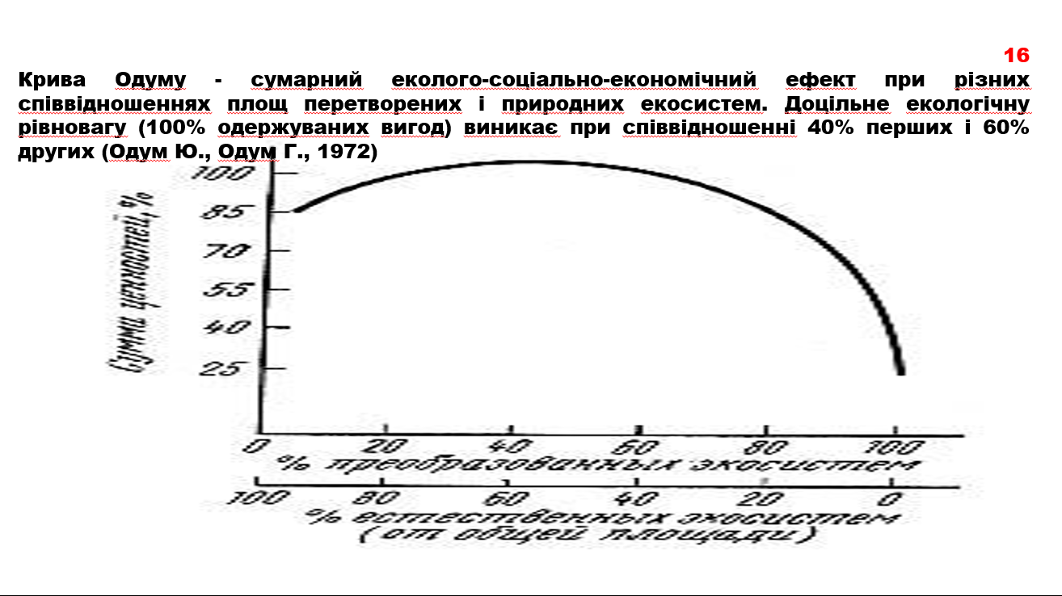
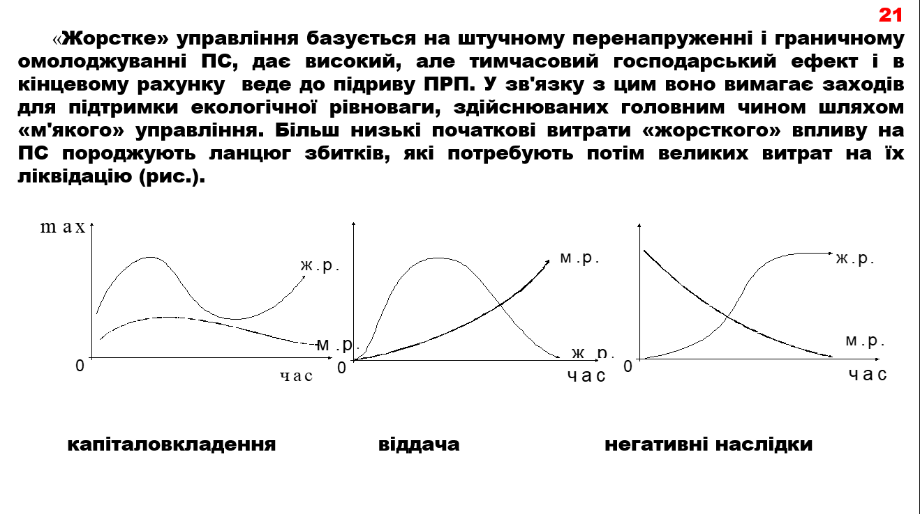
PowerPoint presentation:

Slide 11
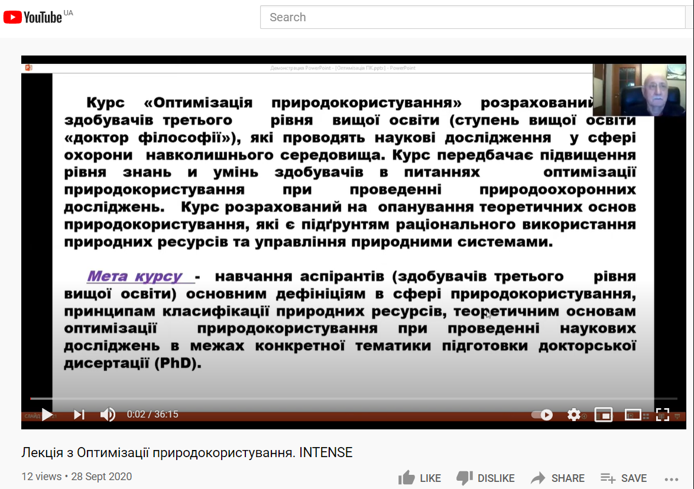
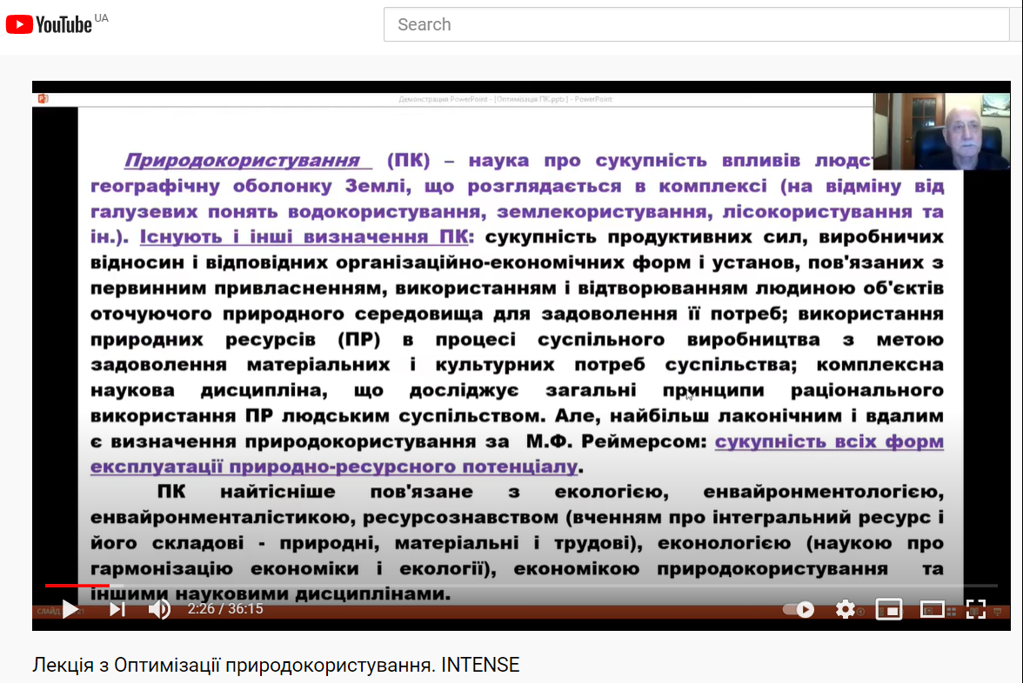
Video lecture :

Slide 12
Practical tasks:

Slide 13
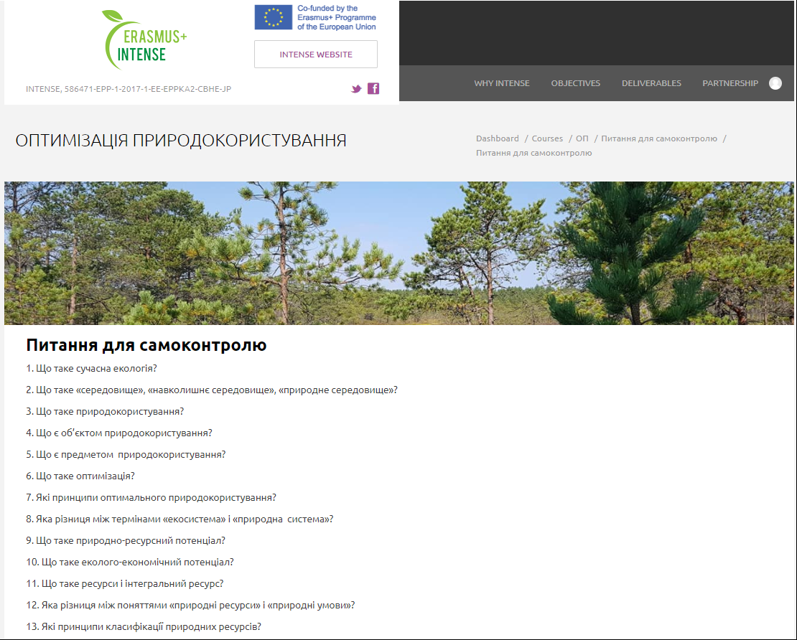
Self-control questions

Slide 14
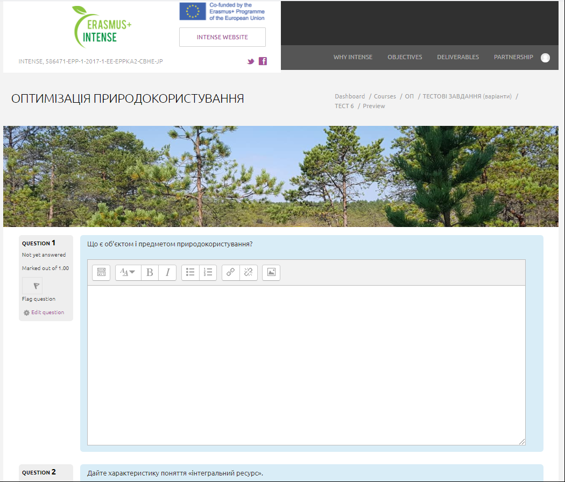
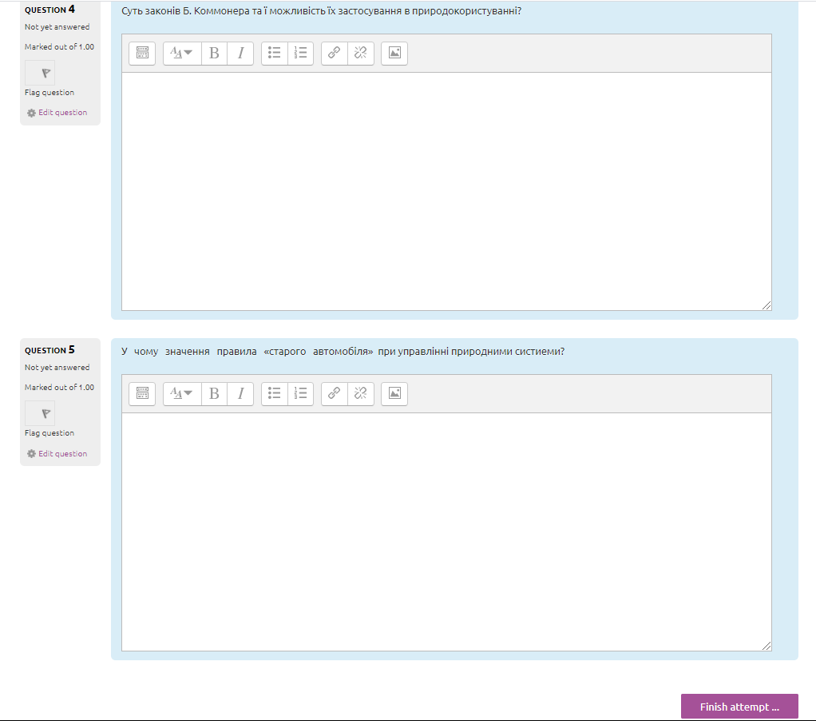
Final knowledge control tests

Slide 15
Course authors:
Coordinator: Тamerlan Safranov,
Odessa State Environmental University (OSENU, Ukraine)
safranov@ukr.net
Authors/Lecturers: Тamerlan Safranov, Alla Kolisnyk,
Odessa State Environmental University (OSENU, Ukraine)

