Slide 1
Pollution of Ecosystems with Mineral Fertilizers
Course presentation:
ERASMUS+ project “INTEGRATED DOCTORAL PROGRAM FOR ENVIRONMENTAL POLICY, MANAGEMENT AND TECHNOLOGY – INTENSE”

Slide 2
Summary
A package of documents has been developed for the course, which includes: lecture notes, study guides for practical work, tests with explanation of answers for self-control and control tests for knowledge control.
The lectures cover the concepts and conditions of the functioning of ecosystems, agroecosystems, environmental factors, environmental conditions and their division, the causes of environmental damage by natural and anthropogenic factors.
Particular attention is given to current trends in the application of mineral fertilizers and a brief description of the main types of mineral fertilizers is provided.
The issues of fertilizer classification by composition and effect on ecosystems, agroecological expertise are covered; the characteristics of all components of mineral fertilizers and their positive and negative impact on ecosystems are given.
The characteristics of new types of mineral fertilizers and their agroecological assessment are provided. Quantitative assessment of mineral fertilizer application for various soil types is given. Permissible norms of pollutants are specified.

Slide 3
Aims and objectives
The purpose of the discipline is to provide students with modern knowledge on the causes of environmental pollution, types and kinds of ecosystem pollution, natural and man-made pollutants, the damage they cause in farms, their environmental impact and the damage they cause.
The subject of the discipline is formation of conceptual, categorical, theoretical and methodological apparatus for determination of hazardous pollutants and generalization of data from research and practical activities to study the effect of pollutants and their environmental impact.
Among the main objectives of the course there are also: study into the causes of destruction of the natural balance and emergence of environmentally hazardous phenomena; study into environmental problems caused by anthropogenic changes; study into the impact of mineral fertilizers on the level of contamination of soils and agricultural products; obtaining of skills to determine the criteria for dangerous accumulation of pollutants; formation of graduates' ability to study natural systems on the basis of a multidisciplinary and interdisciplinary approach and to make decisions in conditions of a high level of uncertainty and incorrectly set tasks.

Slide 4
Aims and objectives
The course also covers management socio-economic, climatic, soil, hydrogeological and other solutions that are used for development of human production in various economic sectors for the efficient management and conservation of the environment, and its protection from destruction.
Technologically developed interdisciplinary approaches, which promote joint learning, cooperation and practice exchange on environmental protection, are used to master the course.
For this purpose, lectures, practical and laboratory classes, full-scale field observations, physical and chemical methods of direct, indirect, and remote research of substance; methods of information modelling and processing, as well as equipment and facilities required for laboratory and / or remote study of the composition and structure of soils and fertilizers and their phase composition, are used.

Slide 5
General learning outcomes
Upon completion of the course,
PhD students are to
know the methods for collection, analysis and systematization of scientific, technical, economic and industrial information regarding mineral fertilizers and their application
be ready to find optimal solutions for the application of mineral fertilizers in various natural-and-climatic conditions
have the skills to obtain, store, process and disseminate professional, scientific and technical information
have knowledge in the requirements of normative and other legislative acts on environmental protection, and the ability to apply them for ensuring the functioning of the management system at the enterprise, assessment of the state of the production environment, and determination of the conditions and means of its improvement
have knowledge and skills to apply methods and technologies of the environmental analysis, and forecasting of the pollutant accumulation
have the ability to participate in strategic planning and decision-making on environmental issues, and provide expert advice on various operational issues related to the use or limitation of the impact of weather conditions

Slide 6
General learning outcomes
Upon completion of the course,
PhD students are to
have the ability to analyze, synthesize, creatively comprehend, evaluate and systematize various information sources to perform production tasks
have the skills to assess the socio-economic consequences of soil contamination for the enterprises of the agro-industrial complex to make managerial decisions
comprehend the European Union governance framework and policies and EU objectives for sustainability, and linkages with global environmental goals and programmes
have the ability to identify the main stakeholder groups, analyze their interests and interactions, and compare stakeholders and the structure for providing incentives in Ukraine and the EU

Slide 7
Syllabus

Slide 8
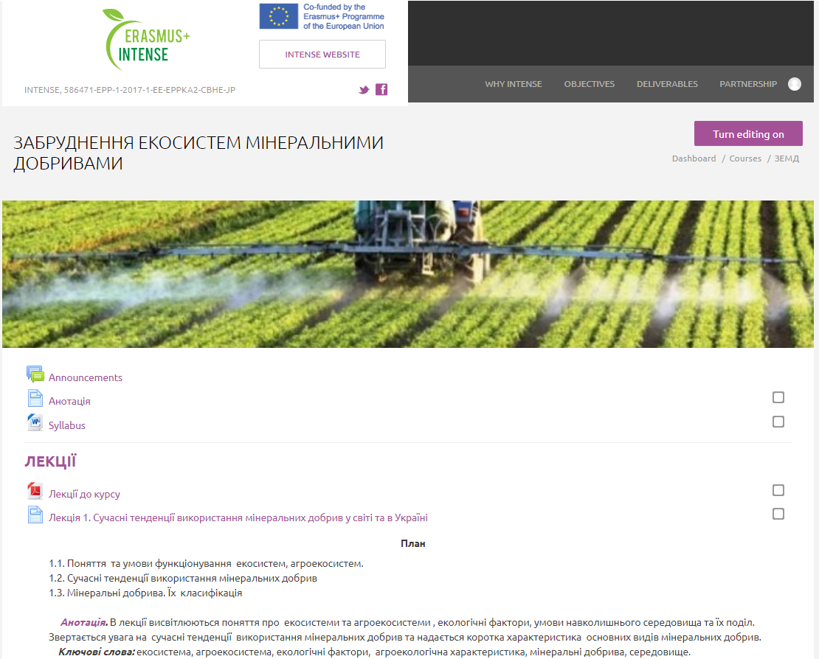
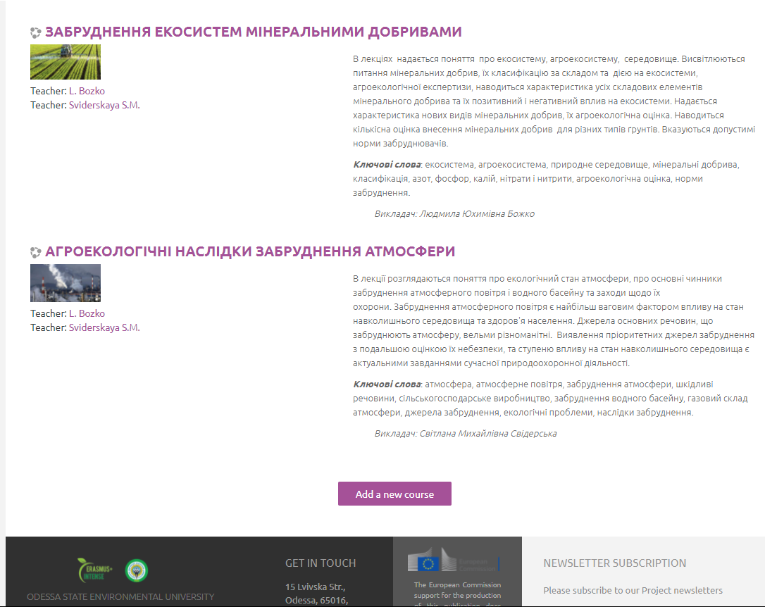
The course is available on the INTENSE open education platform dl.intense.network
http://dl.intense.network/course/view.php?id=21

Slide 9
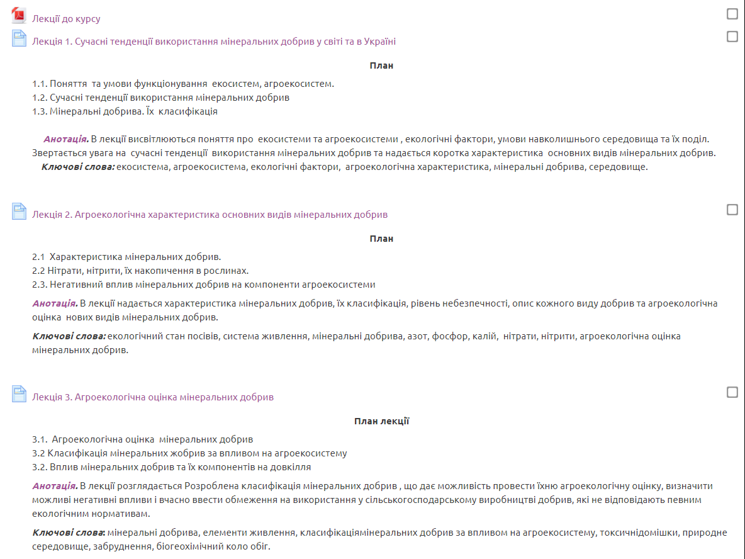

The course is available on the INTENSE open education platform dl.intense.network

Slide 10
Types and forms of classes, methods of interaction between teacher and student
The course ‘Pollution of Ecosystems with Mineral Fertilizers’ is studied by PhD students in the term 1, consists of 3 sections, as well as self-control and final tests.
The course includes
theoretical material: lectures in html, a presentation, a video lecture
practical tasks
a self-control test
a final knowledge control test
The course consists of a complex of lectures on 3 topics and 3 practical tasks.

Slide 11
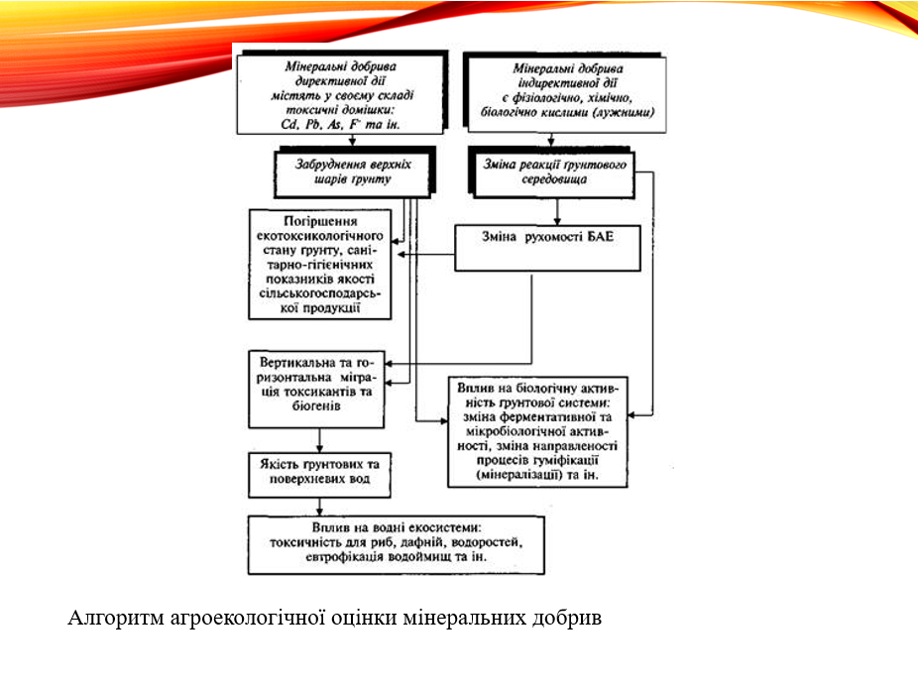
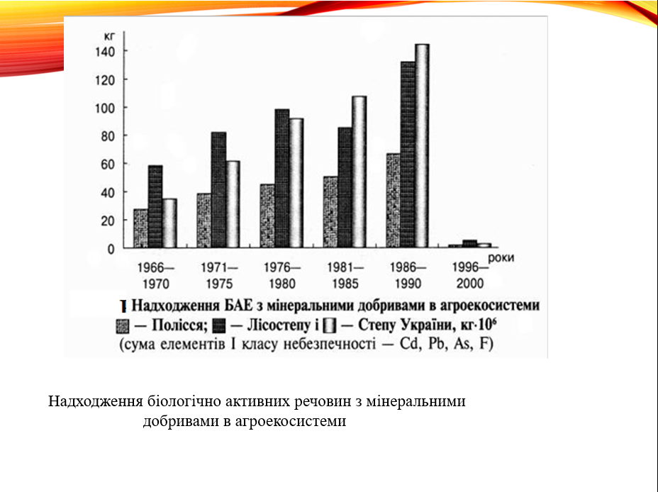
PowerPoint presentation:

Slide 12
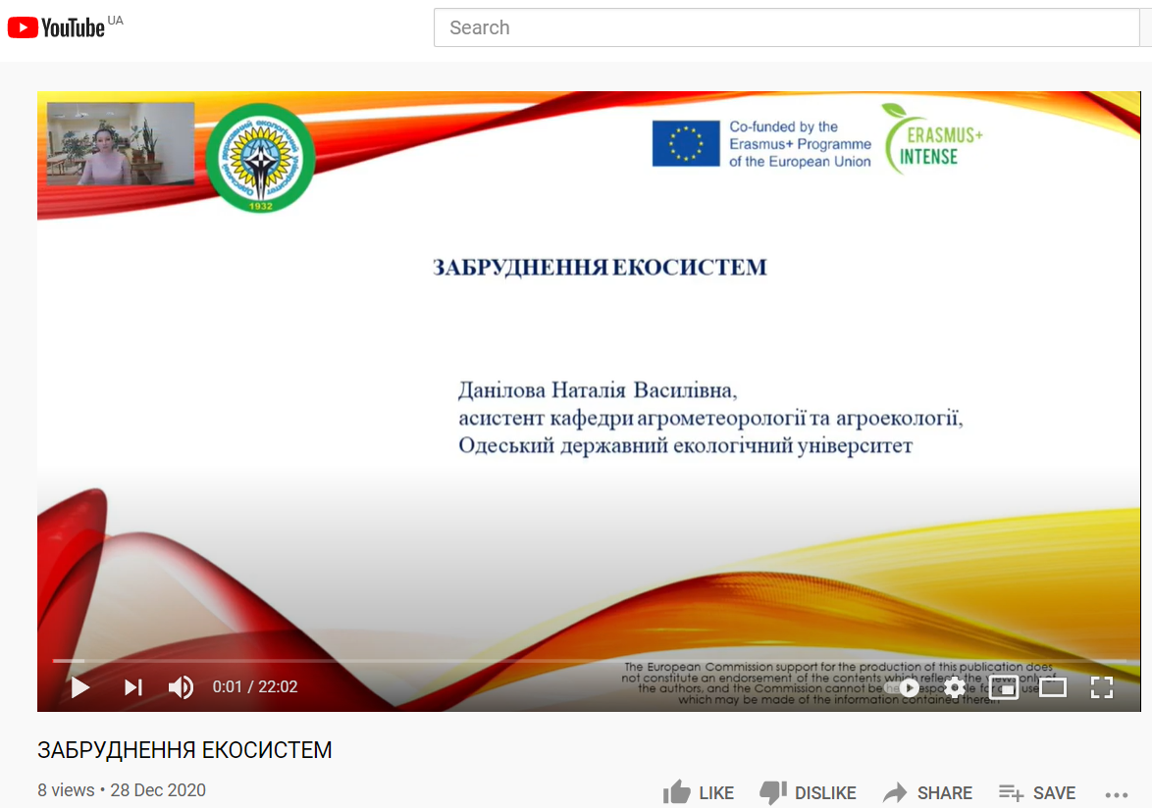
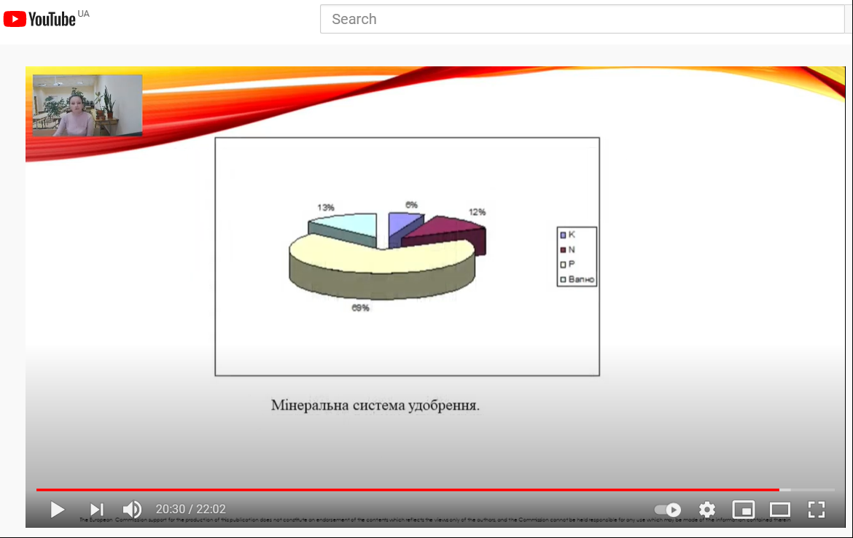
Video lectures :

Slide 13
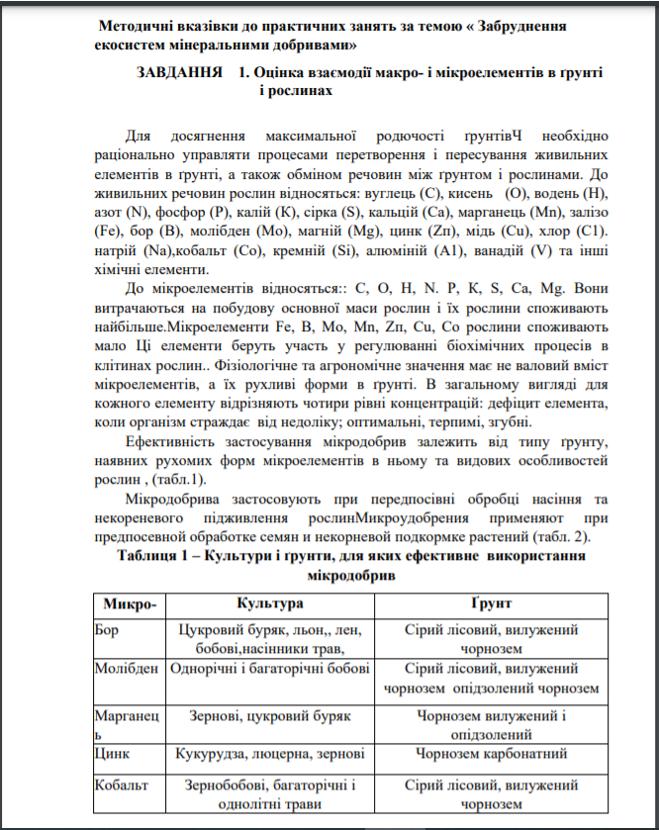
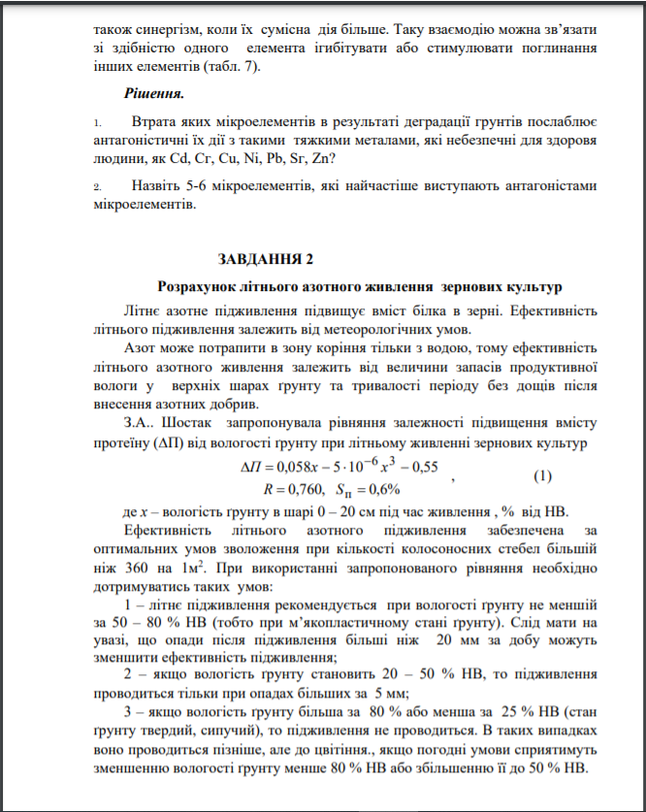
Practical tasks:

Slide 14
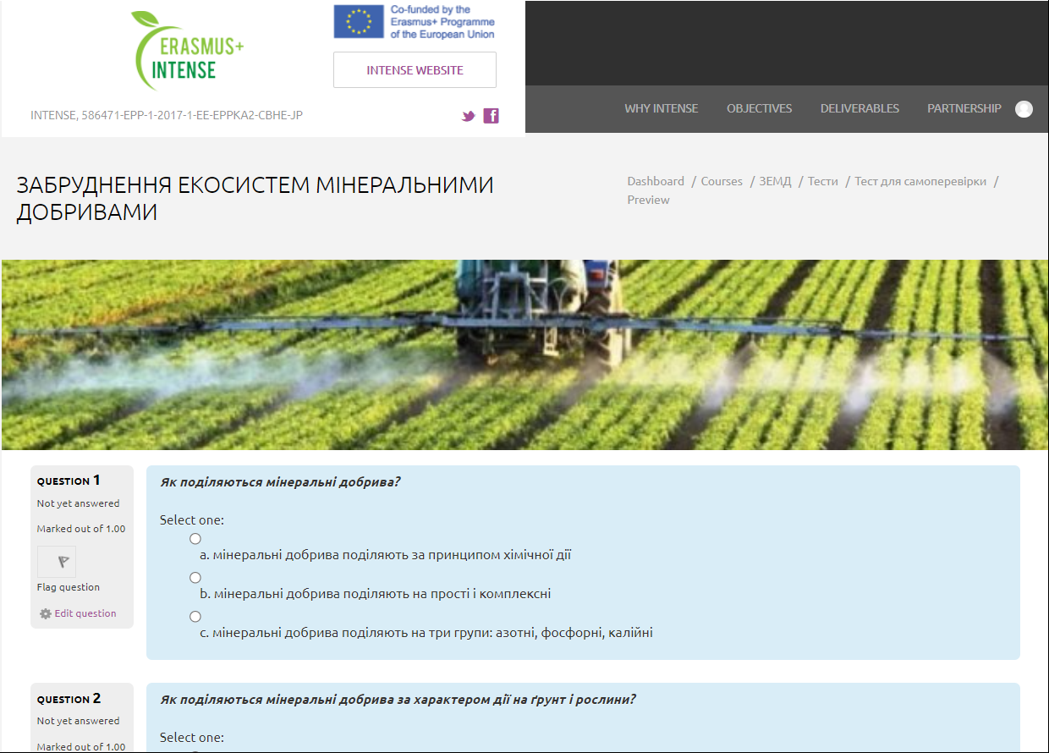
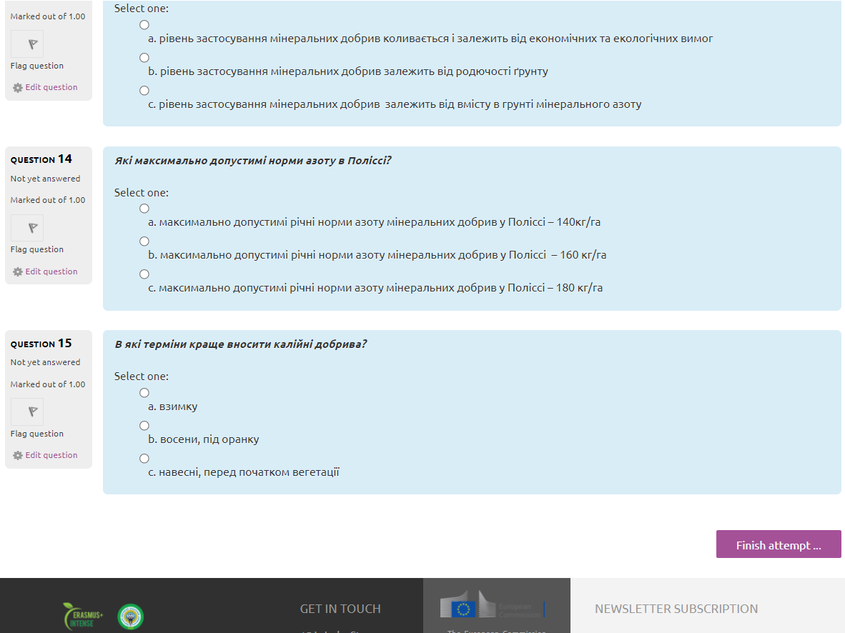
Self-control test

Slide 15
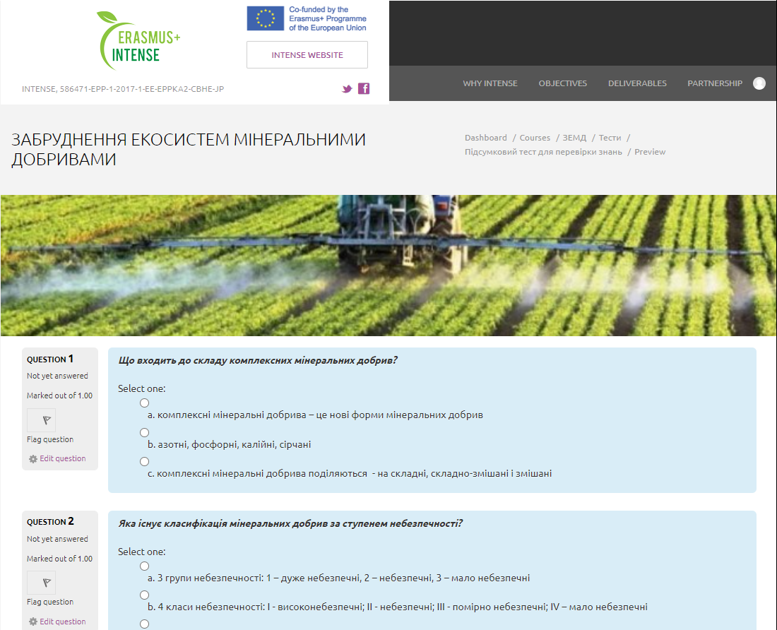
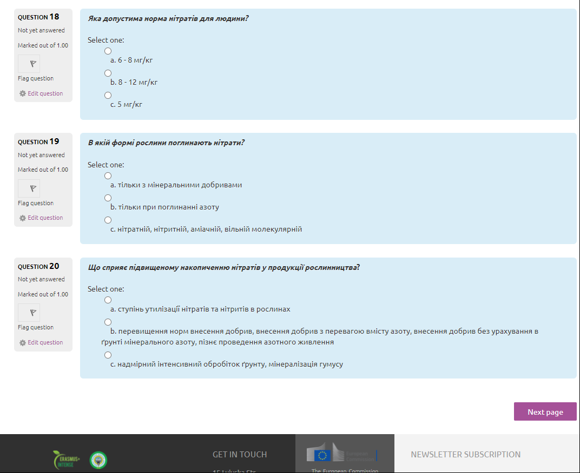
Final knowledge control test

Slide 16
Course authors:
Coordinator: Anatolii Polovyi,
Odessa State Environmental University (OSENU, Ukraine)
apolevoy@te.net.ua
Authors: Anatolii Polovyi, Liudmyla Bozhko,
Odessa State Environmental University (OSENU, Ukraine)

