Slide 1
INTENSE e-Science
ERASMUS+ project “INTEGRATED DOCTORAL PROGRAM FOR ENVIRONMENTAL POLICY, MANAGEMENT AND TECHNOLOGY – INTENSE”
Web-sites: http://intense.network/e-science/, http://dl.intense.network/

Slide 2
Purpose
The INTENSE e-science modules are aimed at providing assistance to research trainees with their research through shared access to laboratory facilities, research databases, libraries, models and analytical tools.
The target audience is MSc and PhD students at partner HEIs.

Slide 3
Description
E-science supports the complete scientific lifecycle: experimental design, data collection and analysis to publication.
The e-science modules contain Methodological Guidelines on Research and Supervision, as well as links to research databases, libraries, real life observations, research and study versions of models and analysis tools, etc.

Slide 4
The e-science components
General information on the module with the list of recommended libraries, models and analytical tools
Methodological guidelines on research and supervision for post-graduated students
The links for joint access of project partners to the equipment and databases.

Slide 5
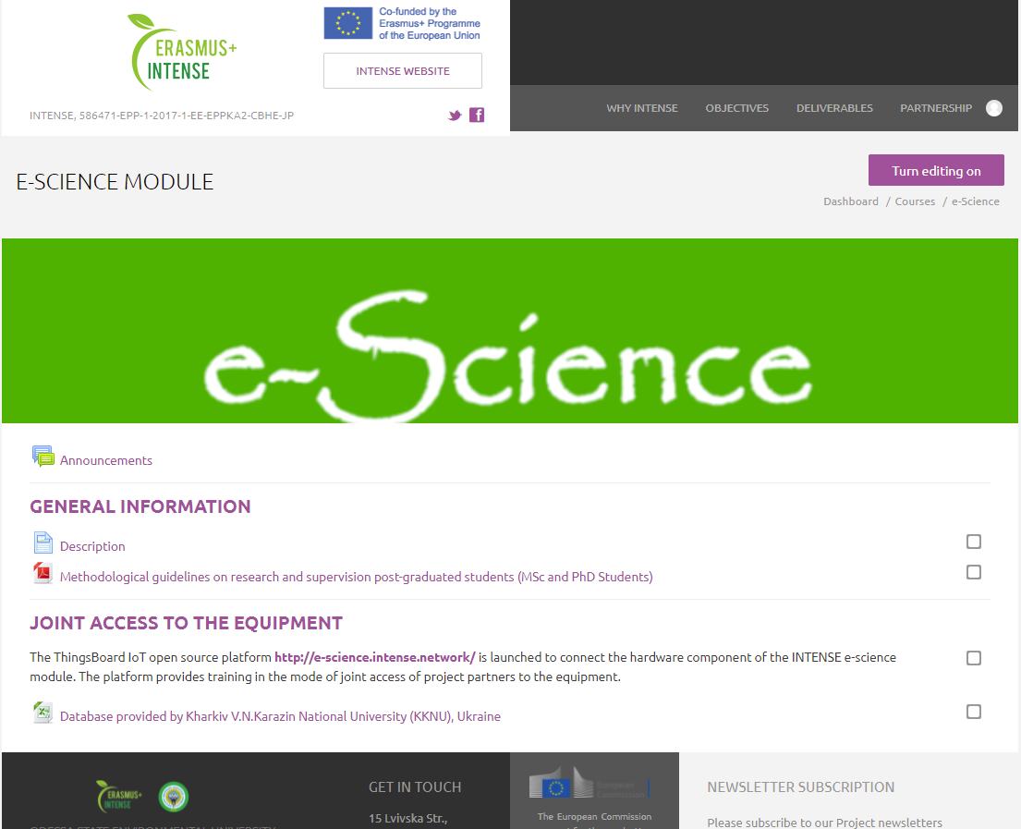
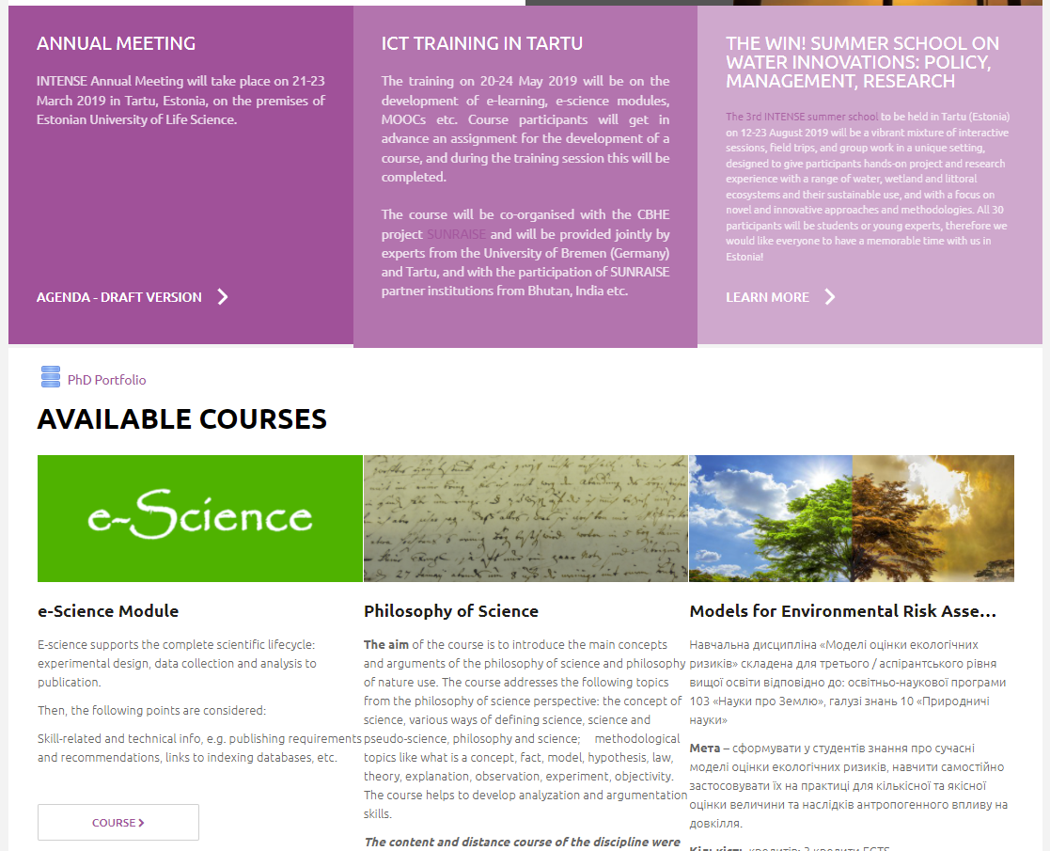
Access to INTENSE e-science module
The INTENSE e-science module can be accessed at the web-page http://dl.intense.network/

Slide 6
Additional information can be found at the web-pages
The IT platform, which is used for the implementation of e-science modules, is ThingsBoard Open-source IoT http://e-science.intense.network/
The supporting materials can be accessed at the web-page http://intense.network/e-science/

Slide 7
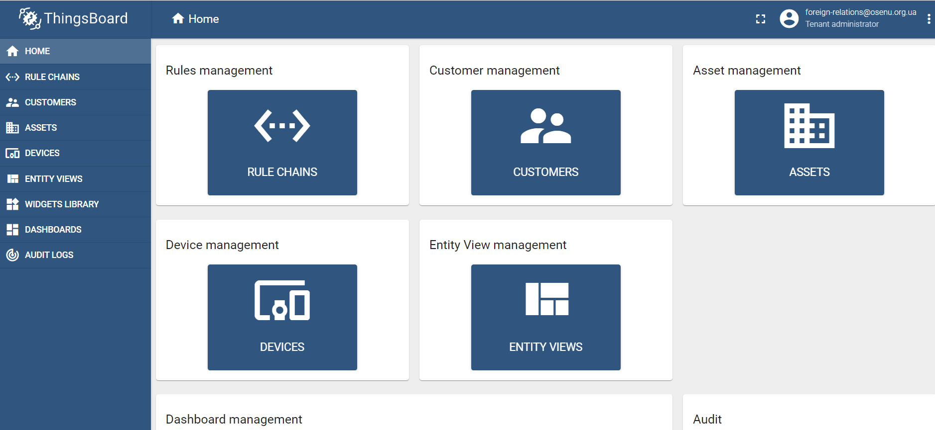
ThingsBoard Open-source IoT

Slide 8
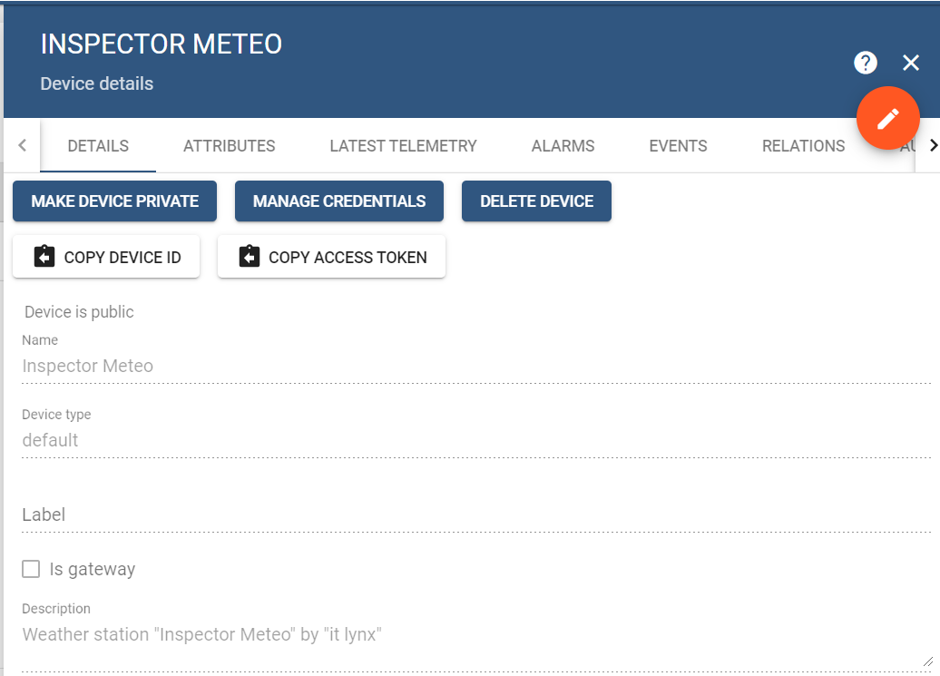
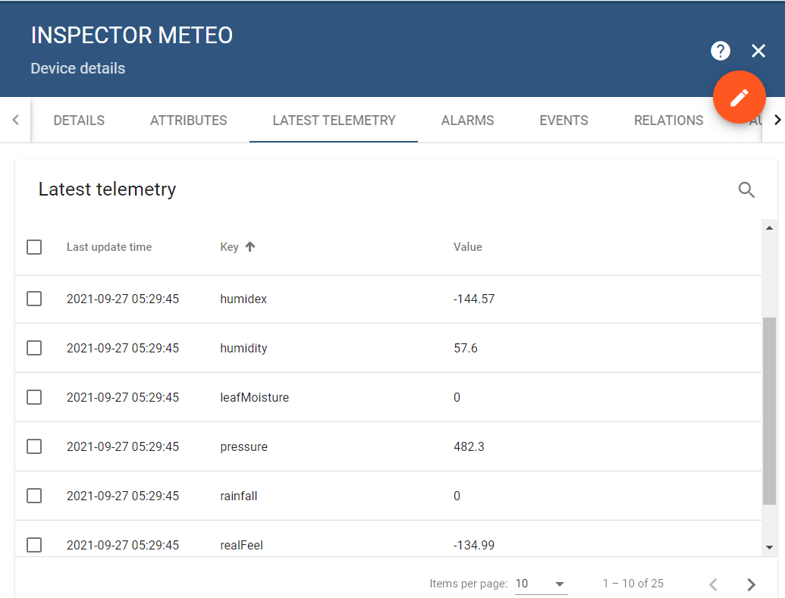
Devices: Weather station "Inspector Meteo"

Slide 9
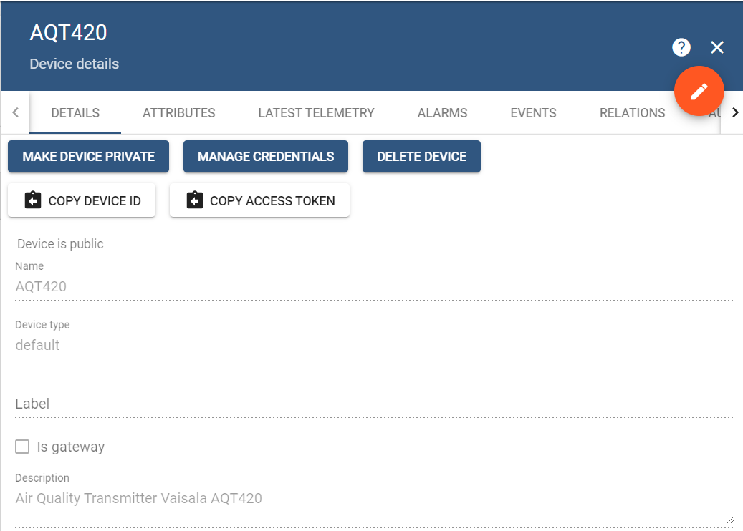
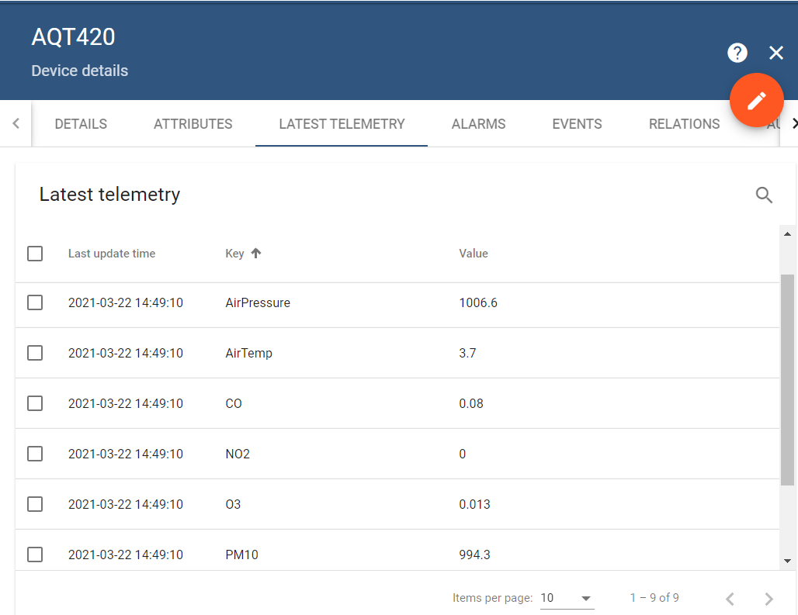
Devices: Air Quality Transmitter Vaisala AQT420

